Slide 1


Slide 2
Enterprise Resource Planing (ERP)
sebuah aplikasi manajemen bisnis yang memudahkan pengelolaan bisnis secara terintegrasi
FRM
HRM
MRP
ERP
SCM
CRM

Slide 3
What is odoo ?
Odoo (formerly OpenERP and before that, TinyERP) is a suite of open core enterprise management applications. Targeting companies of all sizes, the application suite includes billing, accounting, manufacturing, purchasing, warehouse management, and project management.
ERP (more then ERP) Application
ERP/Application Framework
Web Framework (Backend & Frontend)

Slide 4

Formaly OpeERP
Since 2005 has been developed as TinyERP by Febian P. (Belgium)
2,000,000 users
Enjoying using Odoo to run their business
1500 developers
In the Odoo community
4000 apps
To cover all your business needs
620 license partners
Offering services to customers
120 countries
Covered by our official partners

Slide 5
OPEN SOUCE
Python ( Object Modeling )
XML ( View, Meta Data, Template )
HTML5 ( View, Template )
Javascript
CSS / LESS
Bootstrap

Slide 6
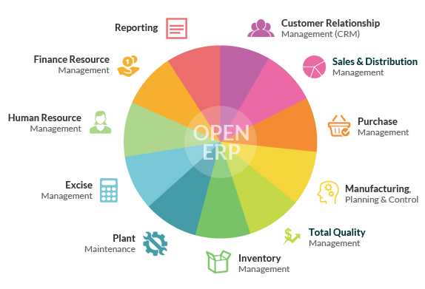

Slide 7
Contoh Aplikasi :
List feature : multiuser, multi….., integrasi, bisnis proses ???

Slide 8
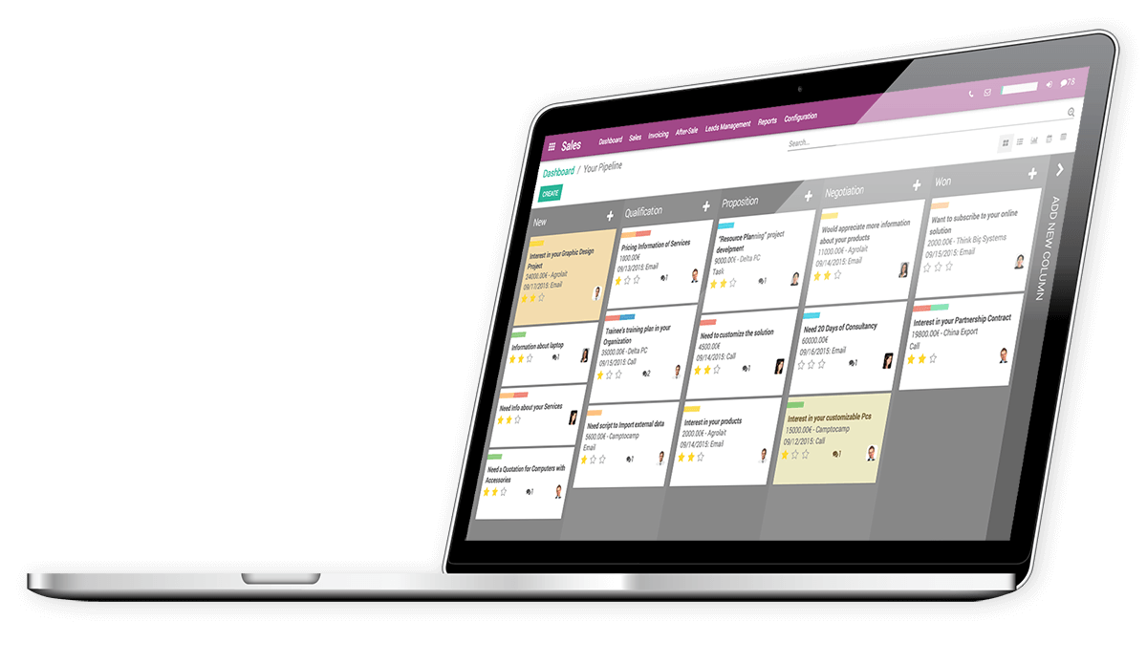

Slide 9
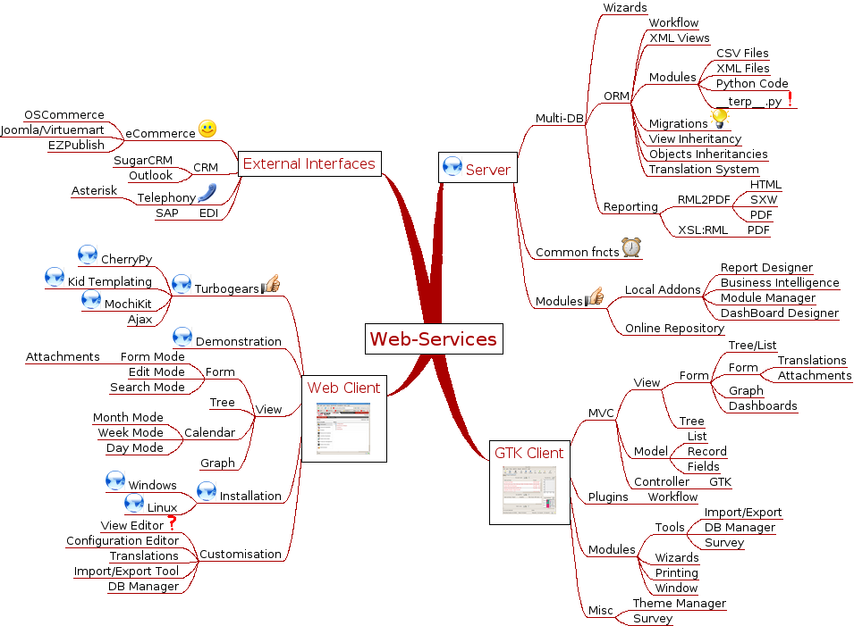
Odoo Arc

Slide 10
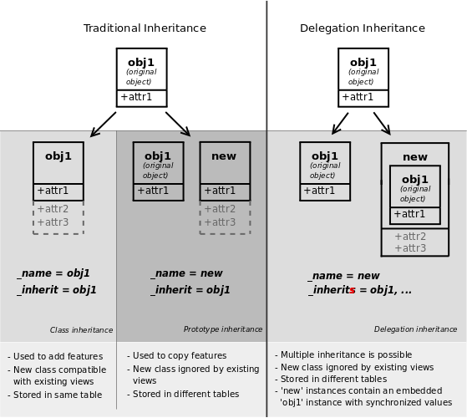

Slide 11
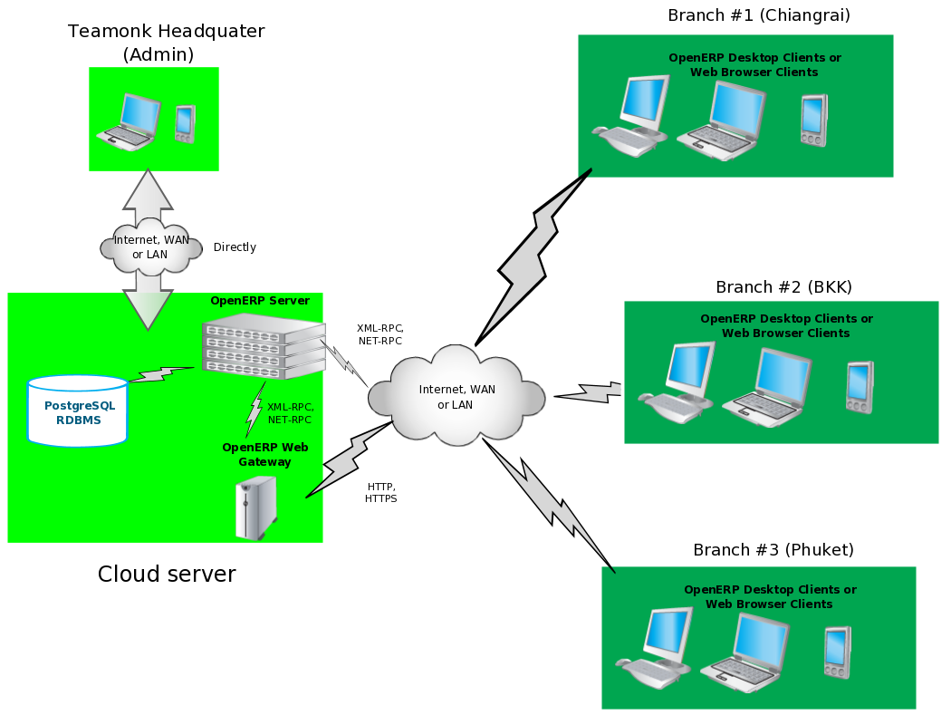

Slide 12
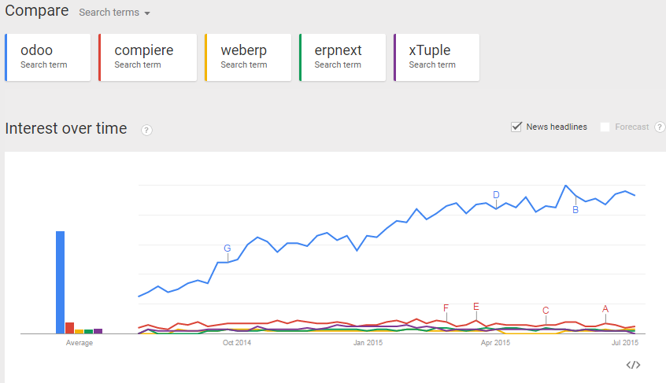

Slide 13
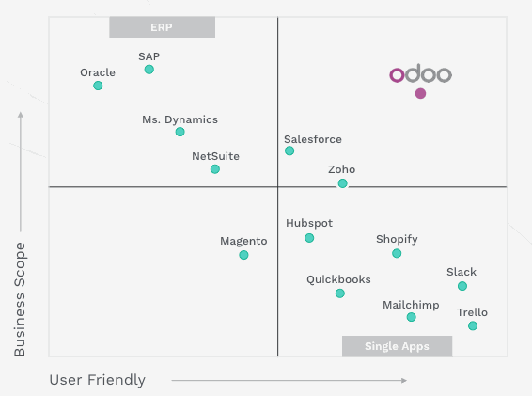

Slide 14
Links & Ref
https://www.jetbrains.com/pycharm/download
https://nightly.odoo.com/
https://www.odoo.com/apps
https://www.odoo.com/page/docs (!!!)
https://github.com/odoo
https://github.com/oca

